Slide 1

OMM
Obesity Management Medications
WHEN, HOW, WHY AND WHY NOT
Dr. Giulia Maria Pontesilli
Medicina Interna
Ospedale Santa Maria della Misericordia, Rovigo

Slide 2

WHEN?

Slide 3
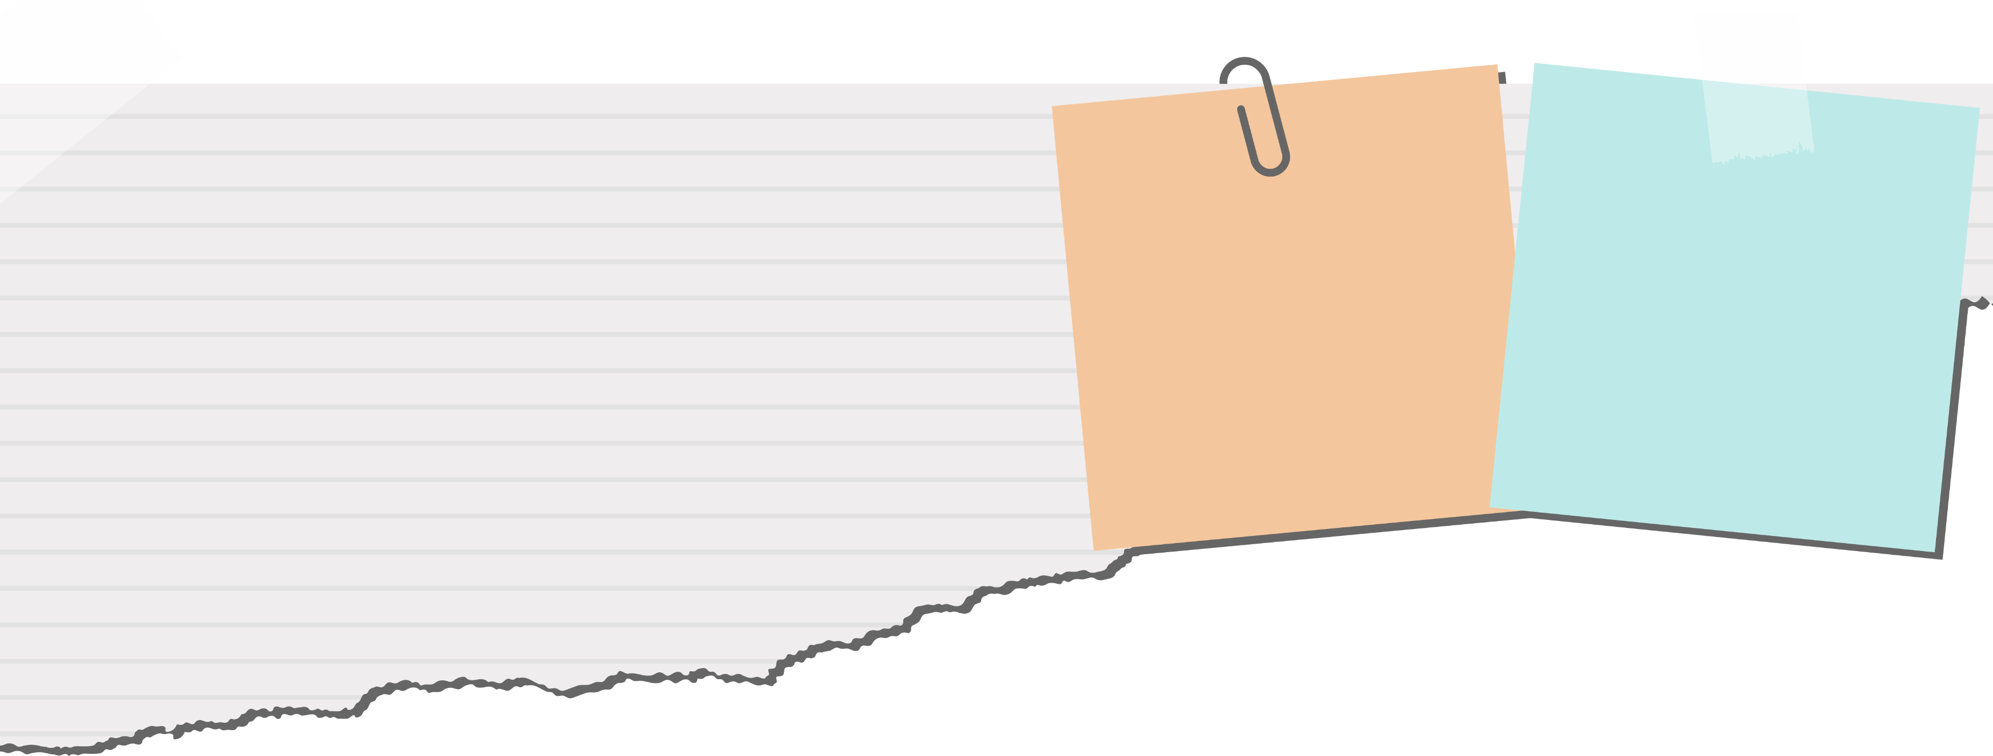
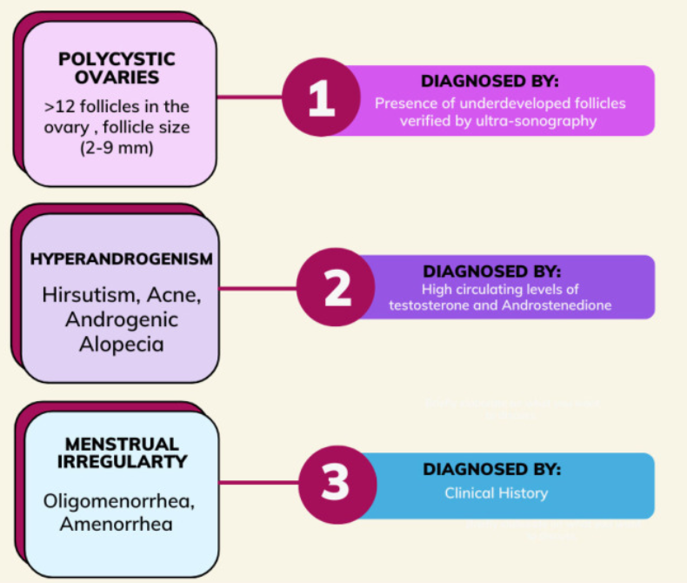
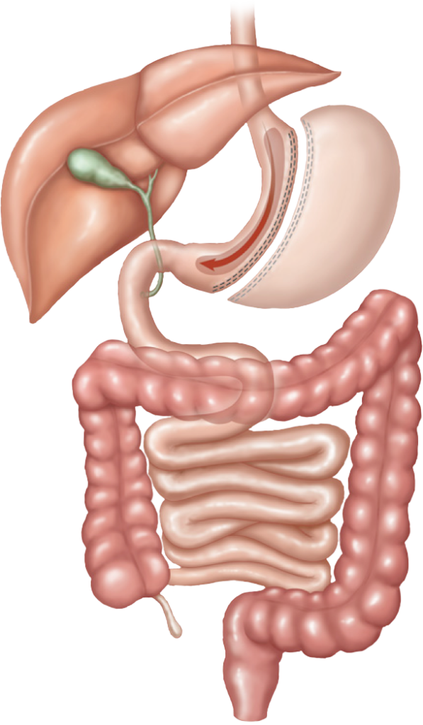
M.S. ♀ 34 anni
Ipertensione arteriosa, IGT, PCOS
Desidera una gravidanza
Sleeve gastrectomy
Peso post chirurgico a 18 mesi: 113 kg
19 kg
( = 14% BW, 28% EBW)
BMI 51
(132 Kg, 160 cm)
Peso ideale: 64 kg
EBW: 68 kg
Perdita di peso insufficiente
(IWL, insufficient weight loss)
Perdita di < 50% del peso in eccesso (EWL) a 18 mesi dall’intervento
Successo terapeutico
Perdita di almeno il 50% del peso in eccesso (EWL)
Yu Y, Klem M Lou et al., (2019) Predictors of weight regain after sleeve gastrectomy: an integrative review. Surgery for Obesity and Related Diseases
Nedelcu M et al., (2016) Weight regain after bariatric surgery-how should it be defined? Surg Obes Relat Dis.

Slide 4
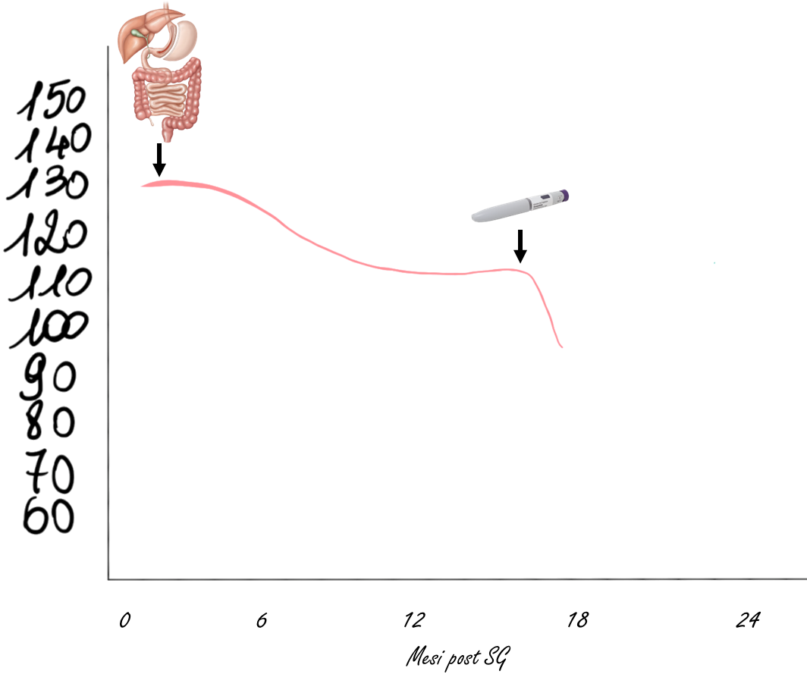

Kg
Nelle pazienti con PCOS e desiderio di fertilità,
tirzepatide è controindicato finché non saranno noti i suoi effetti teratogeni. In caso di utilizzo, è prudente prevedere un periodo di washout e posticipare il concepimento di almeno 2-3 mesi dalla sospensione.

Slide 5
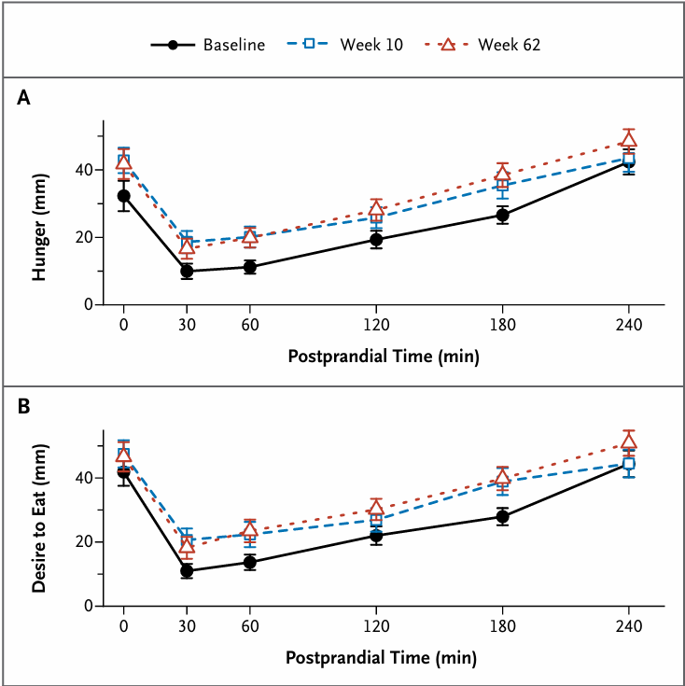
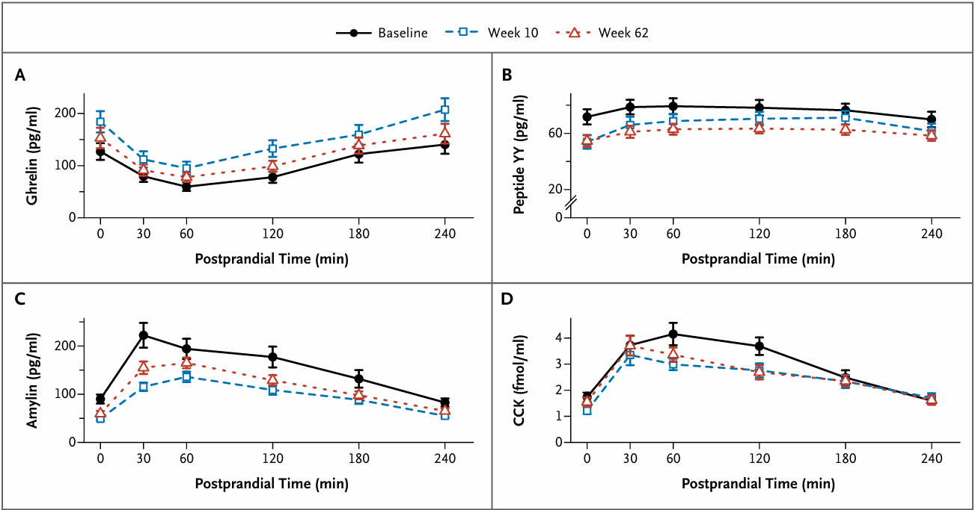
Persistenza a lungo termine degli adattamenti ormonali alla perdita di peso
Sumithran, P.et al. (2011) Long-Term Persistence of Hormonal Adaptations to Weight Loss. New England Journal of Medicine.

Slide 6
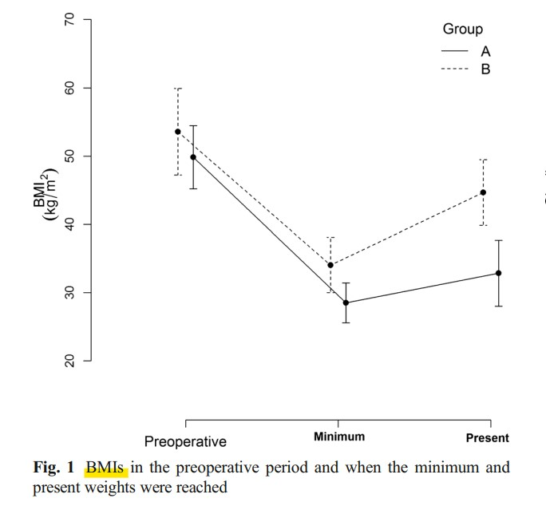
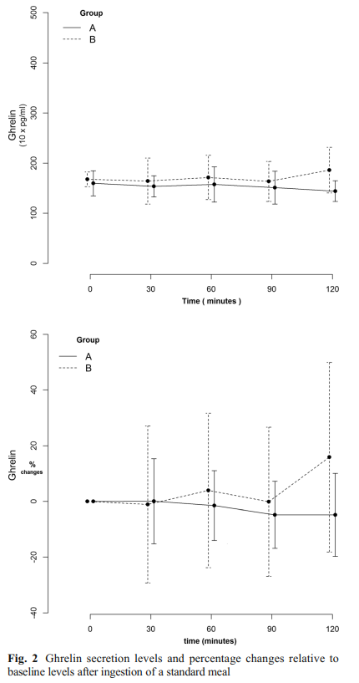
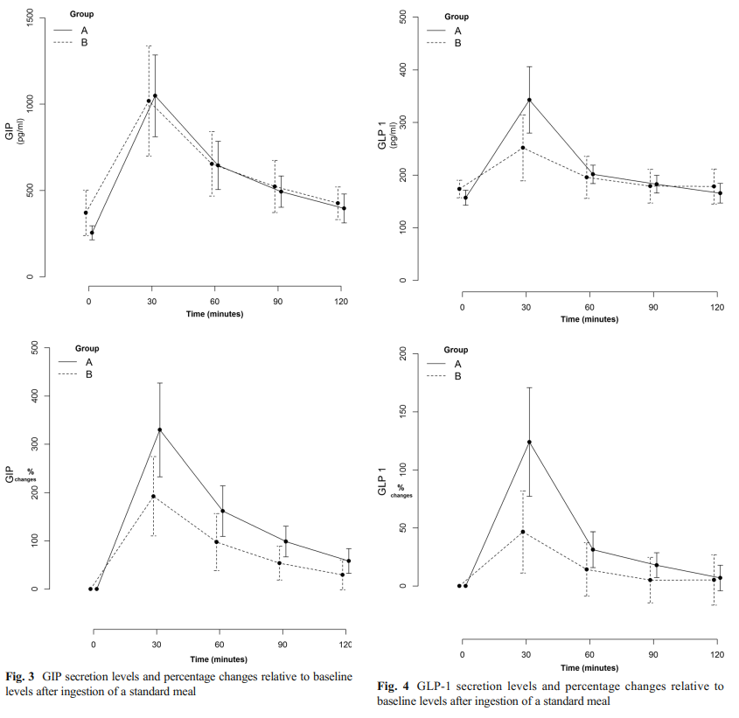
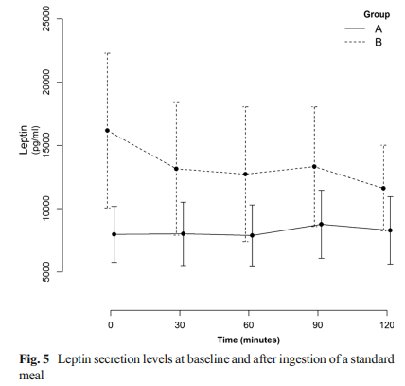
Ruolo degli Ormoni Intestinali nel Recupero del Peso
Santo MA et al. Weight Regain After Gastric Bypass: Influence of Gut Hormones. Obes Surg. 2016
Notes:
The aim of the present study was to evaluate the influence of gastrointestinal hormones comparing postprandial secretion of ghrelin, glucose-dependent insulinotropic polypeptide (GIP), glucagon-like peptide 1 (GLP-1), and leptin between patients with weight regain and those with favorable weight control.
Twenty-four patients with follow-up from 27 to 59 months were divided into two groups according to sustained weight loss
Group A: successful weight loss sustenance after the initial successful weight loss (maximum %EWL >50 %) and maintaining up to 50 % of the weight
Group B: unsatisfactory weight loss sustenance after the initial successful weight loss, with regain of >50 % of the weight lost
Basal serum levels of ghrelin, GIP, GLP-1, and leptin after fasting and 30, 60, 90, and 120 min after a standard meal were measured
There was no difference in the ghrelin secretion. There was a difference in the GIP secretion, with a higher percentage increase in 30 min in group A (330 %×192.2 %; p=0.01). There were also differences in the GLP-1 secretion, with higher increases in absolute (p=0.03) and percentage values after 30 min in group A (124 %×46.5 %; p=0.01). There was also a difference between baseline leptin values, with higher levels in group B (p=0.02). Conclusions The secretion of gut hormones in patients with weight regain after RYGB is different from that in patients with satisfactory weight outcome. After meal stimulation, reduced levels of GIP and GLP-1 may indicate the influence of gut hormones in the process of weight regain.
These adjustments depend on the emptying of the gastric pouch, and reaching more promptly the small intestine promotes the rapid exposure of the intestinal epithelium to nutrients.
GRELINA
Decreased ghrelin levels were reported after RYGB; certainly, this change in hormonal secretion affects weight loss by regulating appetite control [16, 34, 35]. The fact that the baseline levels of ghrelin were similar in groups A and B indicates that these levels did not significantly increase in the group who regained weight.
GIP
Previous studies differ with regard to the change in GIP levels after bariatric surgery. Some studies have shown decreased GIP levels at fasting in patients with diabetes [37] and in the postprandial period [38], whereas other studies have shown increased secretion in the postprandial period, with consequent favorable metabolic effects [39, 40], although there is a discussion whether the changes in GIP levels persist 1 year after RYGB [39]. The most important role of GIP is likely associated with glucose metabolism via the incretin effect because some degree of resistance to the effects of GIP has been reported in patients with diabetes [41]. The analysis of the percentage change after nutrient intake indicates that the increase in GIP levels was more pronounced in group A, suggesting that the GIP secretion profile among individuals with satisfactory weight control was distinct from that of individuals with weight regain, likely indicating a tendency to restore the secretory process, a phenomenon observed after glucose control in patients with diabetes [42]
GLP-1
The preprandial baseline GLP-1 levels were similar in both groups studied. Although decreased GLP-1 levels at fasting after RYGB have been reported [43], which may suggest that an increased baseline level could be expected in the group with a satisfactory course, we highlight that GLP-1 is likely stimulated in response to a meal.
the difference between groups A (satisfactory) and B (unsatisfactory) may suggest that some changes may occur at some point in the weight courses, followed by an attenuation of GLP-1 secretion, similar to what was observed during decreased insulin secretion in the natural course of type 2 diabetes; this mechanism could significantly influence weight regain.

Slide 7
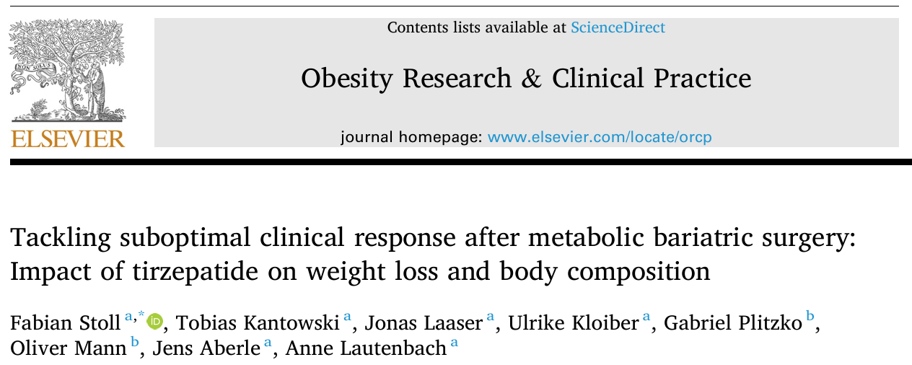
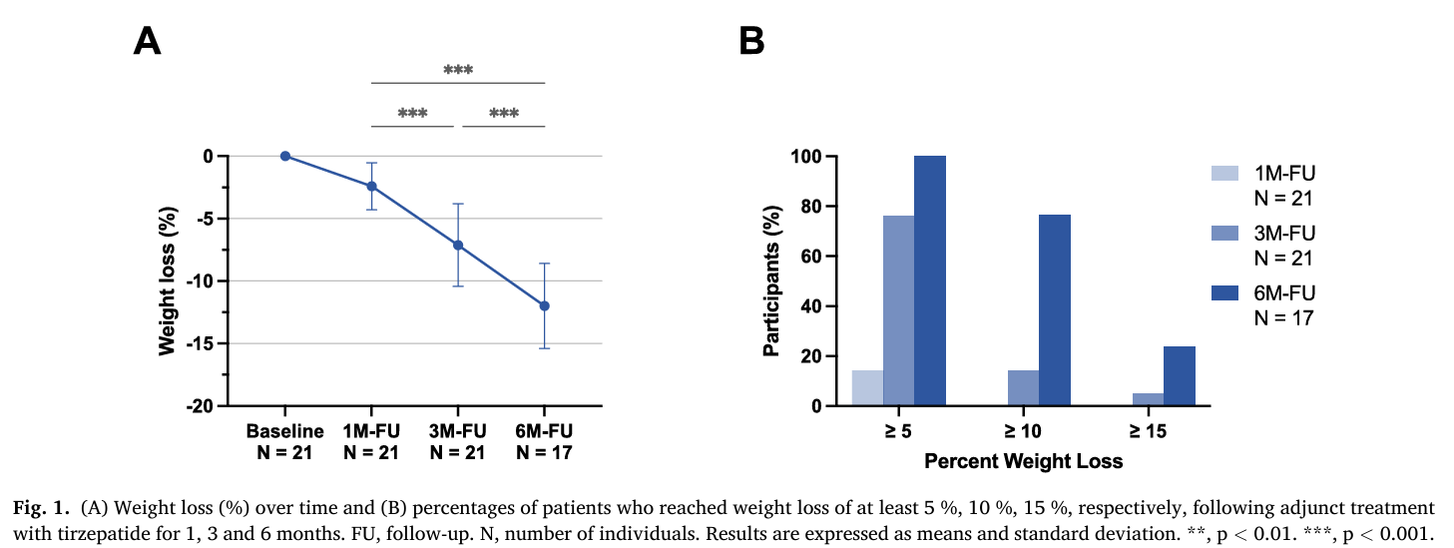

Slide 8

HOW?

Slide 9
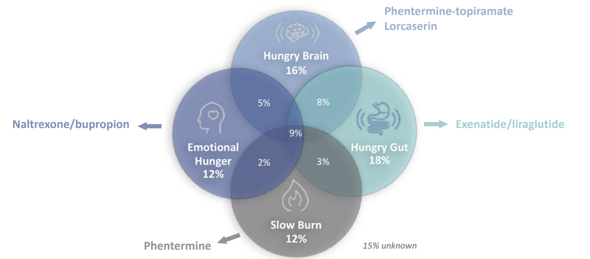
Solo 4 fenotipi di obesità?
Acosta A, Camilleri M, Abu Dayyeh B, Calderon G, Gonzalez D, McRae A, et al. Selection of Antiobesity Medications Based on Phenotypes Enhances Weight Loss: A Pragmatic Trial in an Obesity Clinic. Obesity 2021
Notes:
1. “Hungry brain” – Raise your hand if you can’t seem to feel full despite how much you’ve eaten. This group has to eat more to feel full than other people.
2. “Hungry gut” – These are the folks who eat usual amounts during their meals, but are hungry again even though they have just eaten an hour or two ago.
3. “Emotional hunger” – We’ve all been there. People eat for many reasons but some of us lose control over how much we eat in response to our emotions.
4. “Slow burn” – Some people do all the right things (eating right, exercising, sleeping well, taking care of themselves), but just can’t seem to lose the weight. These are the people who, unfortunately, have a slow metabolism.
1. For the “hungry brain” group, the medication phentermine-topiramate is recommended³. Phentermine has known effects on stimulating the sympathetic nervous system aka the flight-or-flight response system, which suppresses hunger and boosts resting energy expenditure (meaning the calories we burn at rest)⁴. Topiramate, the other part of this combination, enhances the sensation of fullness and decreases impulsive eating⁵. In a study, this combo was shown to work especially well in weight loss for overeaters (those who eat more than 1000 kcal in a meal) as opposed to regular eaters⁶.
2. For the “hungry gut” crowd, the key is slowing down gut transit time³. If you empty your stomach more slowly, you will feel full for longer and overall, eat less, leading to weight loss. Here’s where medications such as liraglutide⁷ or semaglutide⁸ come in. These medicines work by boosting levels of a gut hormone called glucagon-like peptide 1 (GLP-1), which slows down stomach emptying. Recently, semaglutide was even shown to drop weights by around 15% long term.
3. For you “emotional hunger” folks, controlling weight involves improving how you feel on a day-to-day basis³. Hence, the combination naltrexone/bupropion is ideal. Naltrexone cuts down cravings while bupropion, which is a commonly used anti-depressant, improves mood. When our moods are better and we aren’t experiencing strong cravings, it’s a no-brainer that we live better/healthier, which leads to weight loss.
4. Finally, for those with “slow burn” issues, we want to try to speed up metabolism³. We already know that phentermine, as discussed above, does just this. It can be a useful addition to resistance/weight training exercises, which help build muscles. Muscles not only make us look leaner but also use more energy even while at rest, thereby boosting metabolism. Talk about having your cake and eating it too.

Slide 10

C.M. ♂ 59 anni
Ipertensione arteriosa, dislipidemia, OSAS.
Consumo alcolico
BMI 43
(128 Kg, 171 cm)
Peso ideale: 73 kg
EBW: 55 kg
Sleeve gastrectomy
(2017)
Peso post chirurgico a 18 mesi: 103 kg
25 kg
( = 55% EBW)

Slide 11
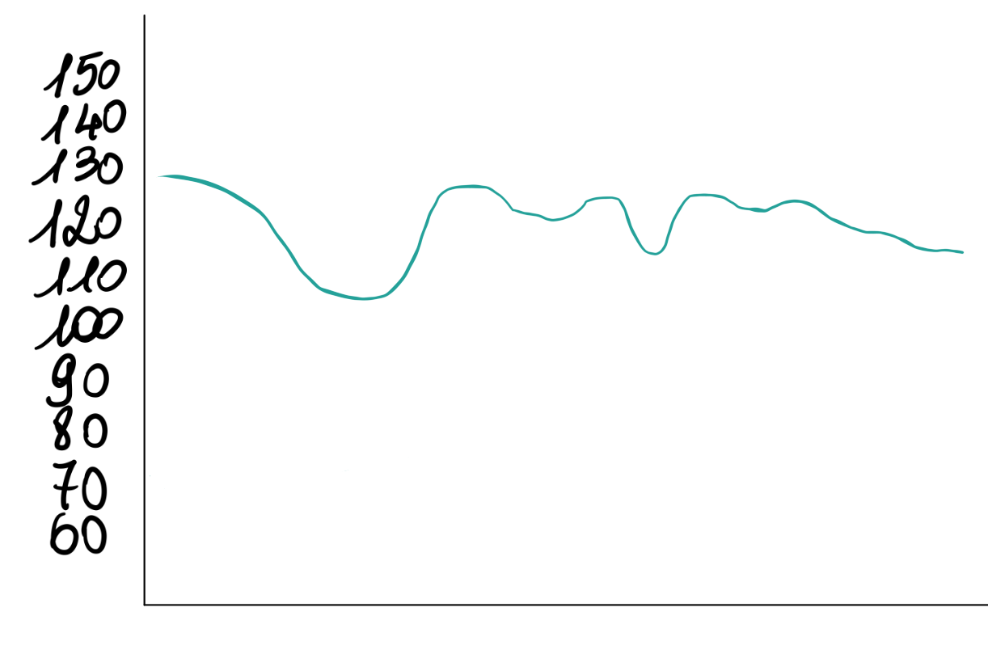
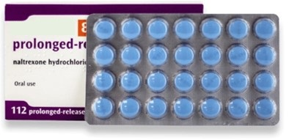
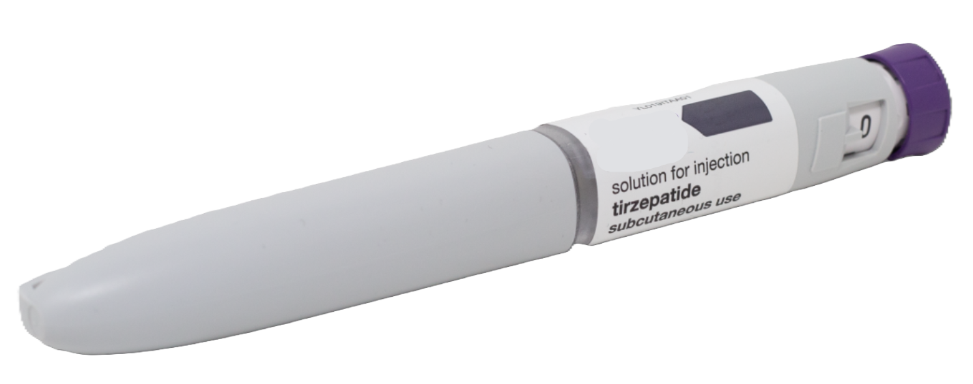
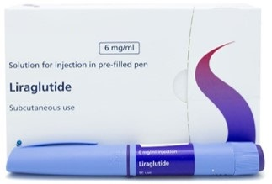

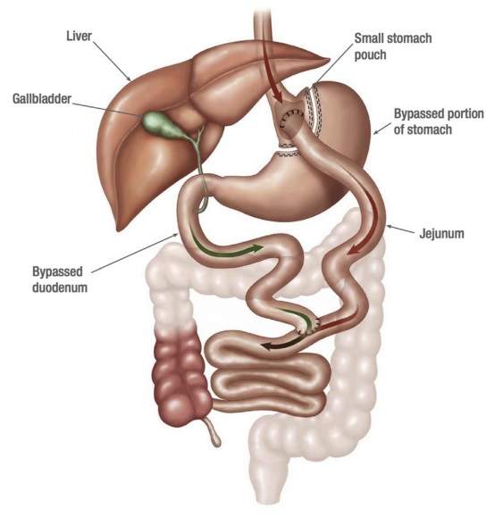
Kg
???
0 6 12 18 24 (7 anni) 0 6 12 18 24 32 38
Mesi

Slide 12
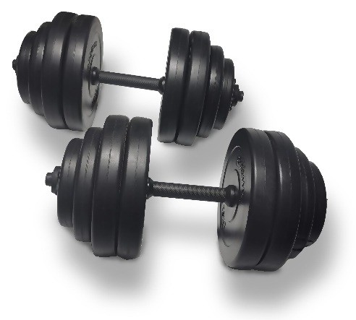
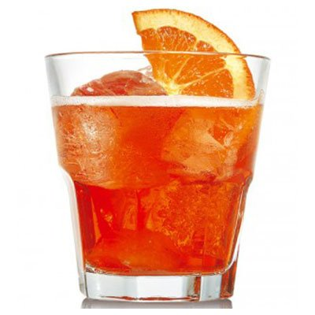
Kg
???
0 6 12 18 24 (5 anni) 0 6 12 18 24 32 38
Mesi

Slide 13
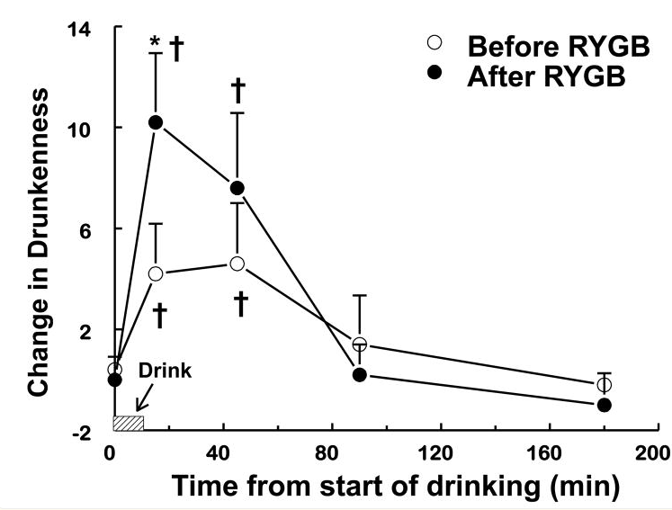
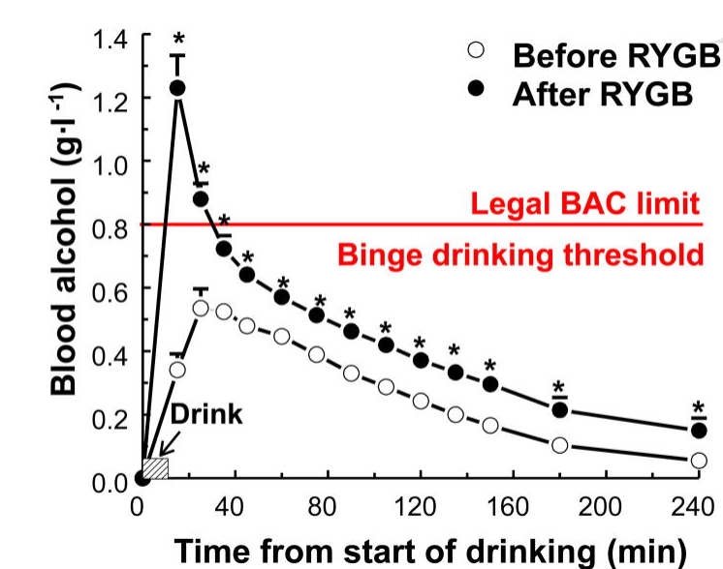
Effetto del RYGB sulla farmacocinetica dell’alcol: ebbrezza doppia a parità di dose
Pepino, M. Y. Et al. (2015). Effect of Roux-en-Y Gastric Bypass Surgery: Converting 2 Alcoholic Drinks to 4. JAMA Surgery
Notes:
RYGB increases the rate of delivery of ingested alcohol into the systemic circulation, resulting in both earlier and higher BAC peaks and a greater feeling of drunkenness. The alteration in alcohol pharmacokinetics means that the peak in BAC achieved after consuming ~2 drinks in women who have had RYGB surgery resembles that observed after consuming ~4 drinks in women who have not had surgery⁶. These findings have important public safety and clinical implications. The BAC in the RYGB+ group exceeded the legal driving limit for 30 min after alcohol ingestion, but never reached the legal driving limit in the RYGB− group. The peak BAC in the RYGB+ group also met the National Institute on Alcohol Abuse and Alcoholism criteria used to define an episode of binge drinking, which is a risk factor for developing AUD. These data underscore the need to make patients aware of the alterations in alcohol metabolism that occur after RYGB surgery to help reduce the risk of potential serious consequences of moderate alcohol consumption.

Slide 14
Le persone con obesità hanno generalmente più massa muscolare rispetto a soggetti normopeso, ma con funzionalità ridotta.
L’obesità è associata a maggior massa muscolare assoluta, ma anche a minor forza relativa, mobilità ridotta, e minor qualità muscolare (miosteatosi, fibre lente).
Qualsiasi perdita di peso comporta perdita di massa muscolare, oltre che di grasso.
La perdita muscolare contribuisce in modo significativo alla riduzione del metabolismo basale (−13 kcal/die per kg muscolo vs −4 kcal/die per kg di grasso).
Dopo una perdita iniziale, il peso tende a stabilizzarsi o a risalire per adattamenti omeostatici (adattamento metabolico).
Circa il 60% della riduzione del metabolismo basale è dovuto alla perdita di tessuti,
il restante 40% a maggiore efficienza energetica (termogenesi adattativa).
Organi come fegato, cuore e reni hanno un metabolismo più elevato rispetto al muscolo scheletrico e perdono massa con il dimagrimento.
La perdita di peso migliora la sensibilità insulinica di muscolo, fegato e tessuto adiposo, anche in presenza di una modesta perdita di massa magra.
L’insulina sopprime la proteolisi muscolare → protegge la massa magra. La resistenza insulinica favorisce la perdita muscolare e la sarcopenia.
Il miglioramento dell’insulino-sensibilità con il calo ponderale può favorire adattamenti positivi nella massa e funzione muscolare.
Farmaci GLP-1 RA e agonisti GLP-1/GIP migliorano l’insulino-sensibilità indirettamente tramite la perdita di peso e direttamente tramite azione insulinotropa.
La proporzione della perdita di massa magra è simile tra dieta, farmaci e chirurgia (ma la quantità totale di peso perso è maggiore con chirurgia e farmaci).

Slide 15
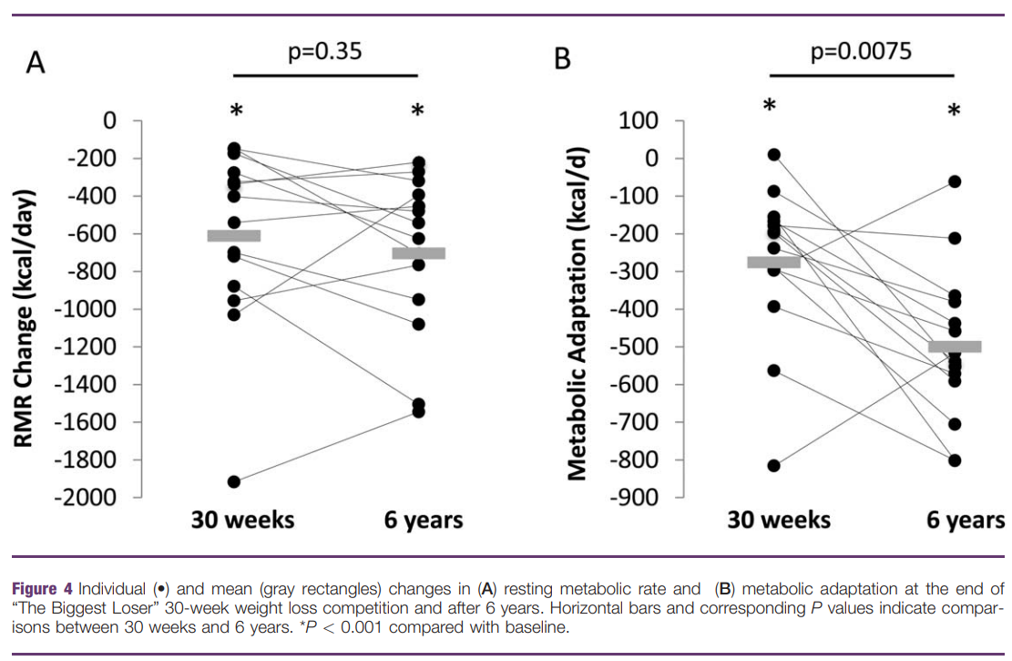

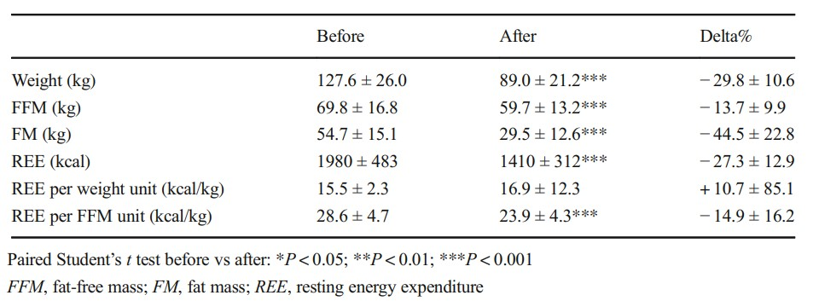

L’adattamento metabolico
REE = Resting Energy Expenditure (kcal/day)
RMR = Resting Metabolic Rate (kcal/day)
Rappresenta il 60-70% della spesa energetica, determinata principalmente dalla composizione corporea
Direttamente proporzionale alla FFM (fat free mass).
L’adattamento metabolico è una riduzione sproporzionata del RMR rispetto alla perdita di peso e di FFM.
Bettini S, et al. Modifications of Resting Energy Expenditure After Sleeve Gastrectomy. Obes Surg 2018
Fothergill E, et al. Persistent metabolic adaptation 6 years after “The Biggest Loser” competition: Persistent Metabolic Adaptation. Obesity. 2016
Notes:
Resting energy expenditure (REE) accounts for 60–70% of 24 h energy expenditure in humans and it is mainly determined by body composition. Stabilization of body weight at a level 10% below the initial weight was associated with negative observed-minus-predicted values for total energy expenditure and non-resting and resting energy expenditure. The magnitude of this metabolic adaptation was clinically significant (around 300 kcal/day for total energy expenditure) [25]. The existence of metabolic adaptation was confirmed in 16 people with class III obesity undergoing an intensive diet and exercise intervention as part of “The Biggest Loser” weight loss competition [27]. Metabolic adaptation has been observed also after bariatric and metabolic surgery. Knut et al. compared metabolic adaptation in 13 pairs of matched patients with obesity that underwent Roux-en-Y Gastric Bypass (RYGB) surgery or participated in “The Biggest Loser” competition: in both groups, REE decreased significantly more than expected based on body composition changes, with the gap being related to the degree of energy imbalance and changes in circulating leptin [28]. (6)
Because FFM is the primary determinant of resting metabolic rate (RMR) (8, 9), a large reduction in FFM is expected to slow the metabolic rate. Furthermore, a suppression of RMR out of proportion to the loss in body weight and FFM may occur through a phenomenon known as adaptive thermogenesis or metabolic adaptation (10–17). Together the loss of FFM along with metabolic adaptation may profoundly decrease resting energy expenditure, slow the rate of weight loss, and may predispose to weight regain. (7) Theoretically any strategy that can lessen the decrease in RMR after weight loss could increase the chances for long-term weight loss success.
Biggest loser 🡪 Despite the relative preservation of FFM, the RMR decreased by 789 ± 483 kcal/d at the end of the study, which was 504 ± 171 kcal/d greater than accounted for by the change of body weight and composition. This metabolic adaptation to the weight loss intervention was also significant at wk 6 but doubled by the end of the competition. Therefore, we showed that a drop in resting metabolism during active weight loss of this magnitude probably cannot be avoided by the addition of an exercise program. […] Although metabolic adaptation acts to decrease the rate of weight loss, it was the subjects with the greatest weight loss who had the greatest metabolic adaptation. This suggests that the magnitude of the intervention plays a role in determining both the degree of weight loss as well as the metabolic response acting to counter weight loss. Mechanistically, the decline in circulating leptin and thyroid hormones may contribute to the metabolic adaptation, with a consequent blunting of sympathetic nervous activity (14, 16, 32, 33). Whereas we found that leptin decreased dramatically with weight loss, neither the degree of weight loss nor metabolic adaptation was directly associated with the change in leptin concentration. (7)
Metabolic adaptation after surgery:
The suppression in REE after Laparoscopic Sleeve Gastrectomy (LSG) and RYGB remained up to 2 years, even after weight loss plateaued (8). Finally, the existence of metabolic adaptation 12 months after surgery was confirmed in a larger sample of 154 patients treated by LSG. In this latter study, a weak but significant inverse correlation between the level of metabolic adaptation and the degree of weight or FM loss in the first year after sleeve gastrectomy was observed, supporting the hypothesis that a greater metabolic adaptation could be partly responsible for a lower weight loss after surgery (9).
Metabolic adaptation has been linked to the rate of energy deficit induced for obtaining weight loss, with the subject having a higher initial gap between their metabolic needs and the prescribed energy intake showing a higher level of metabolic adaptation
REE = Resting Energy Expenditure (kcal/day)
RMR = Resting Metabolic Rate (kcal/day)
Rappresenta il 60-70% della spesa energetica, determinata principalmente dalla composizione corporea
Direttamente proporzionale alla FFM (fat free mass).
L’adattamento metabolico è una riduzione sproporzionata del RMR rispetto alla perdita di peso e di FFM.
Fothergill E, Guo J, Howard L, Kerns JC, Knuth ND, Brychta R, et al. Persistent metabolic adaptation 6 years after “The Biggest Loser” competition: Persistent Metabolic Adaptation. Obesity. 2016
Bettini S, Bordigato E, Fabris R, Serra R, Dal Pra’ C, Belligoli A, et al. Modifications of Resting Energy Expenditure After Sleeve Gastrectomy. Obes Surg 2018

Slide 16

WHY
NOT?

Slide 17

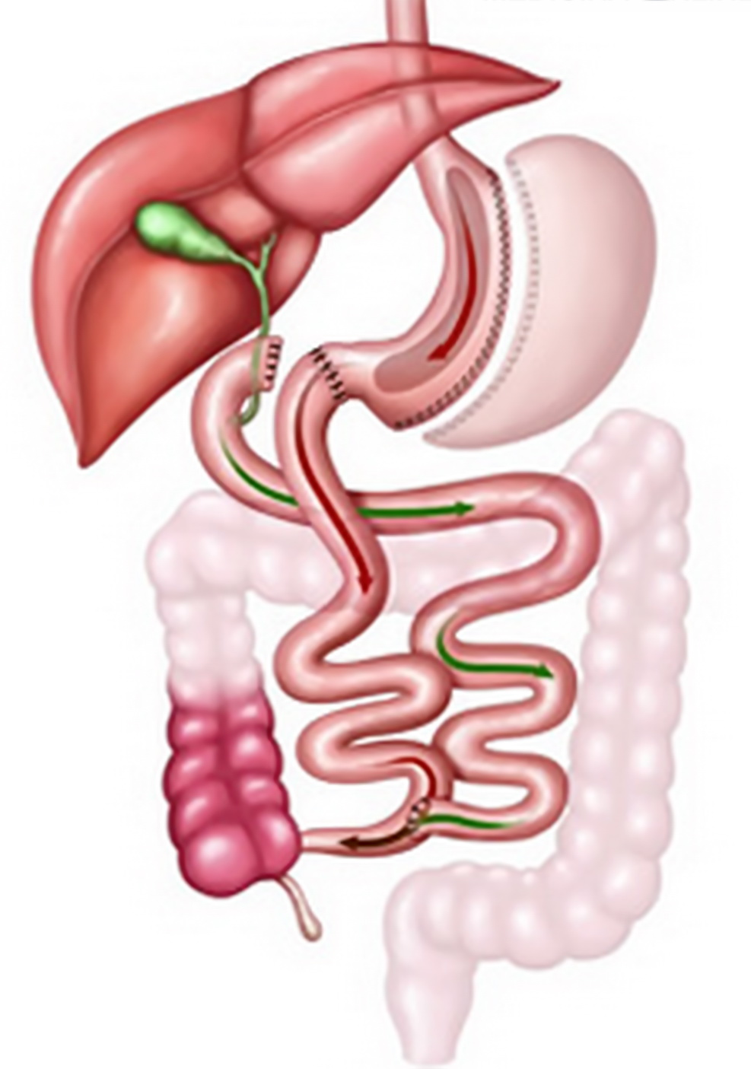
B.G. ♀ 36 anni
«Metabolicamente sana»
Binge eating ritenuto compensato
in terapia farmacologica
…56 anni nel 2024
Ricovero in Medicina per diarrea profusa, calo ponderale di 30 kg (70 kg).
Inoltre: anemia carenziale, ipovitaminosi D, ipoalbuminemia, malnutrizione calorico-proteica, edentulia, crolli vertebrali. Non deambula.
Diagnosi presuntiva di SIBO e intolleranza al glutine non celiaca.
Trattata con ripresa degli integratori specifici, dieta priva di glutine, ciclo di metronidazolo seguito da probiotici.
Diversione biliopancreatica nel 2004, 110 kg
Calo ponderale
fino a 70 kg.
Follow-up scadente.
Recupero ponderale fino a 100 kg in 20 anni.
Presa in carico presso
l’Ambulatorio Internistico Obesità, follow-up ogni 3-6 mesi
Binge eating in labile compenso, paziente in terapia con duloxetina e trazodone, fame scarsamente controllata e con forte componente emotiva.

Slide 18
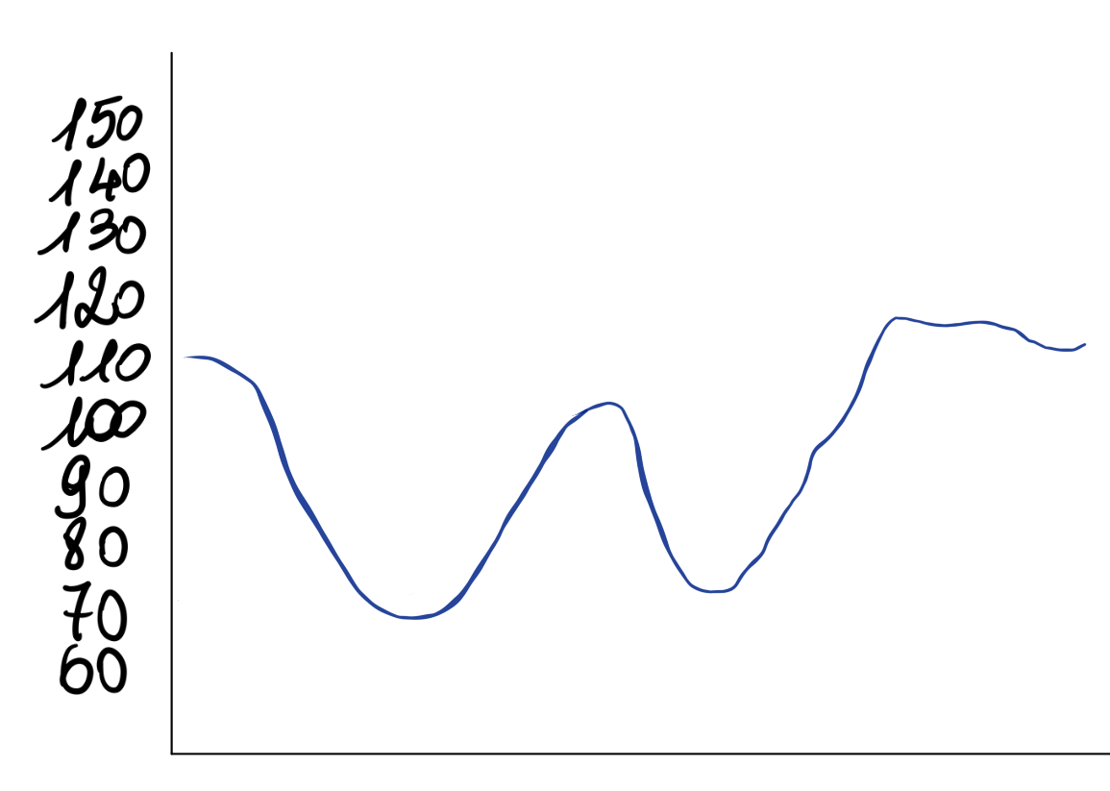
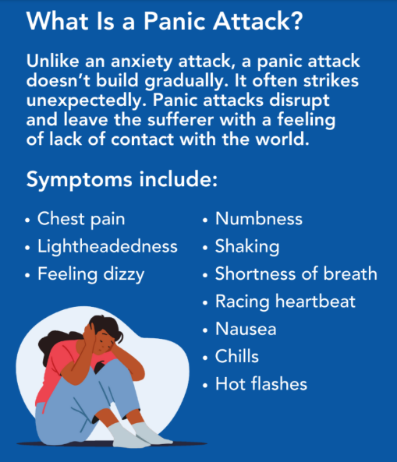

Kg

Slide 19
WHY?

Slide 20
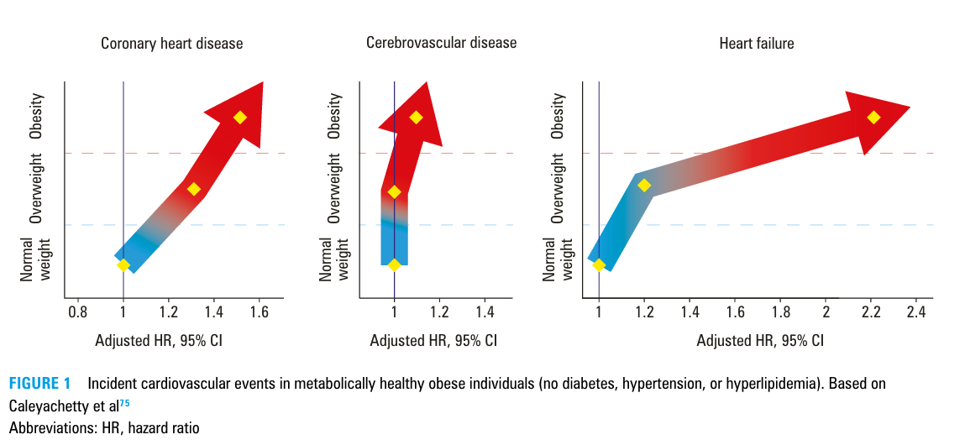
Gajos, G. (2025). Breaking the weight loss paradox: from weight reduction to cardiovascular benefit in obesity treatment. Polish Archives of Internal Medicine

Slide 21
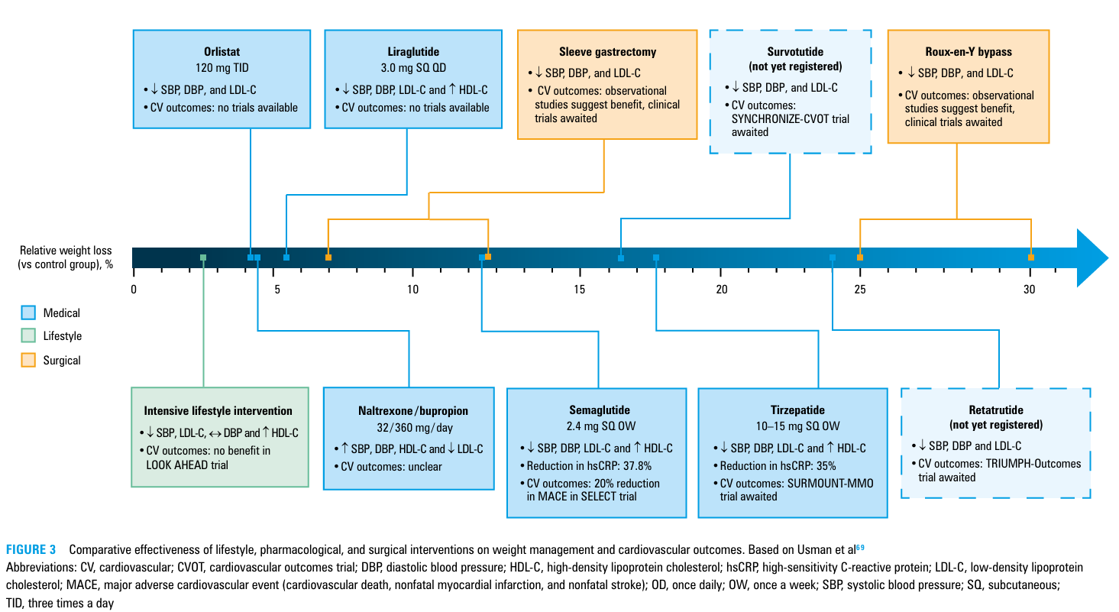
Gajos, G. (2025). Breaking the weight loss paradox: from weight reduction to cardiovascular benefit in obesity treatment. Polish Archives of Internal Medicine

Slide 22
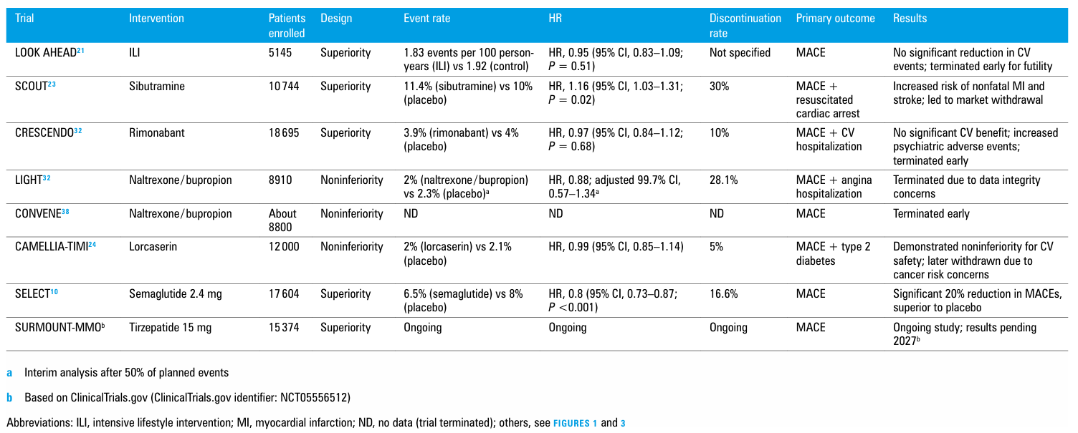
Gajos, G. (2025). Breaking the weight loss paradox: from weight reduction to cardiovascular benefit in obesity treatment. Polish Archives of Internal Medicine

Slide 23
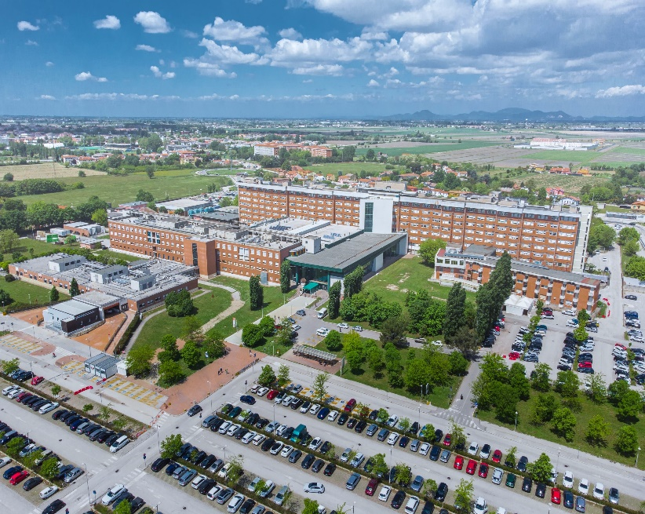

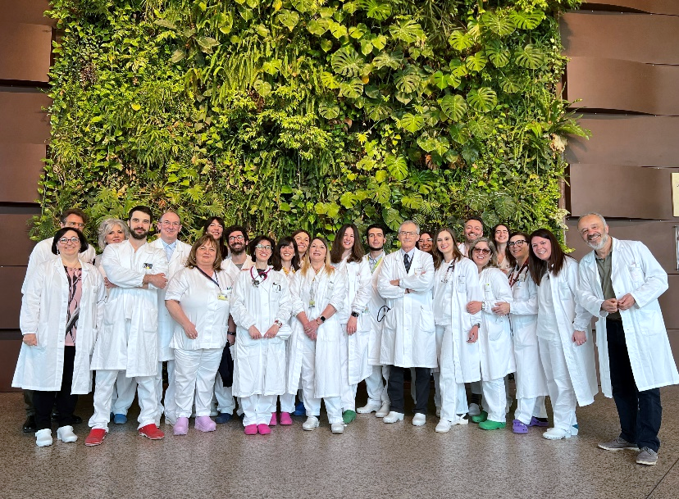

Grazie
giulia.pontesilli@aulss5.veneto.it
AULSS 5 Polesana
Ospedale Santa Maria della Misericordia di Rovigo
AULSS 5 Polesana
U.O.C. Medicina Generale
@giuliamariapontesilli.md

